Slide 1
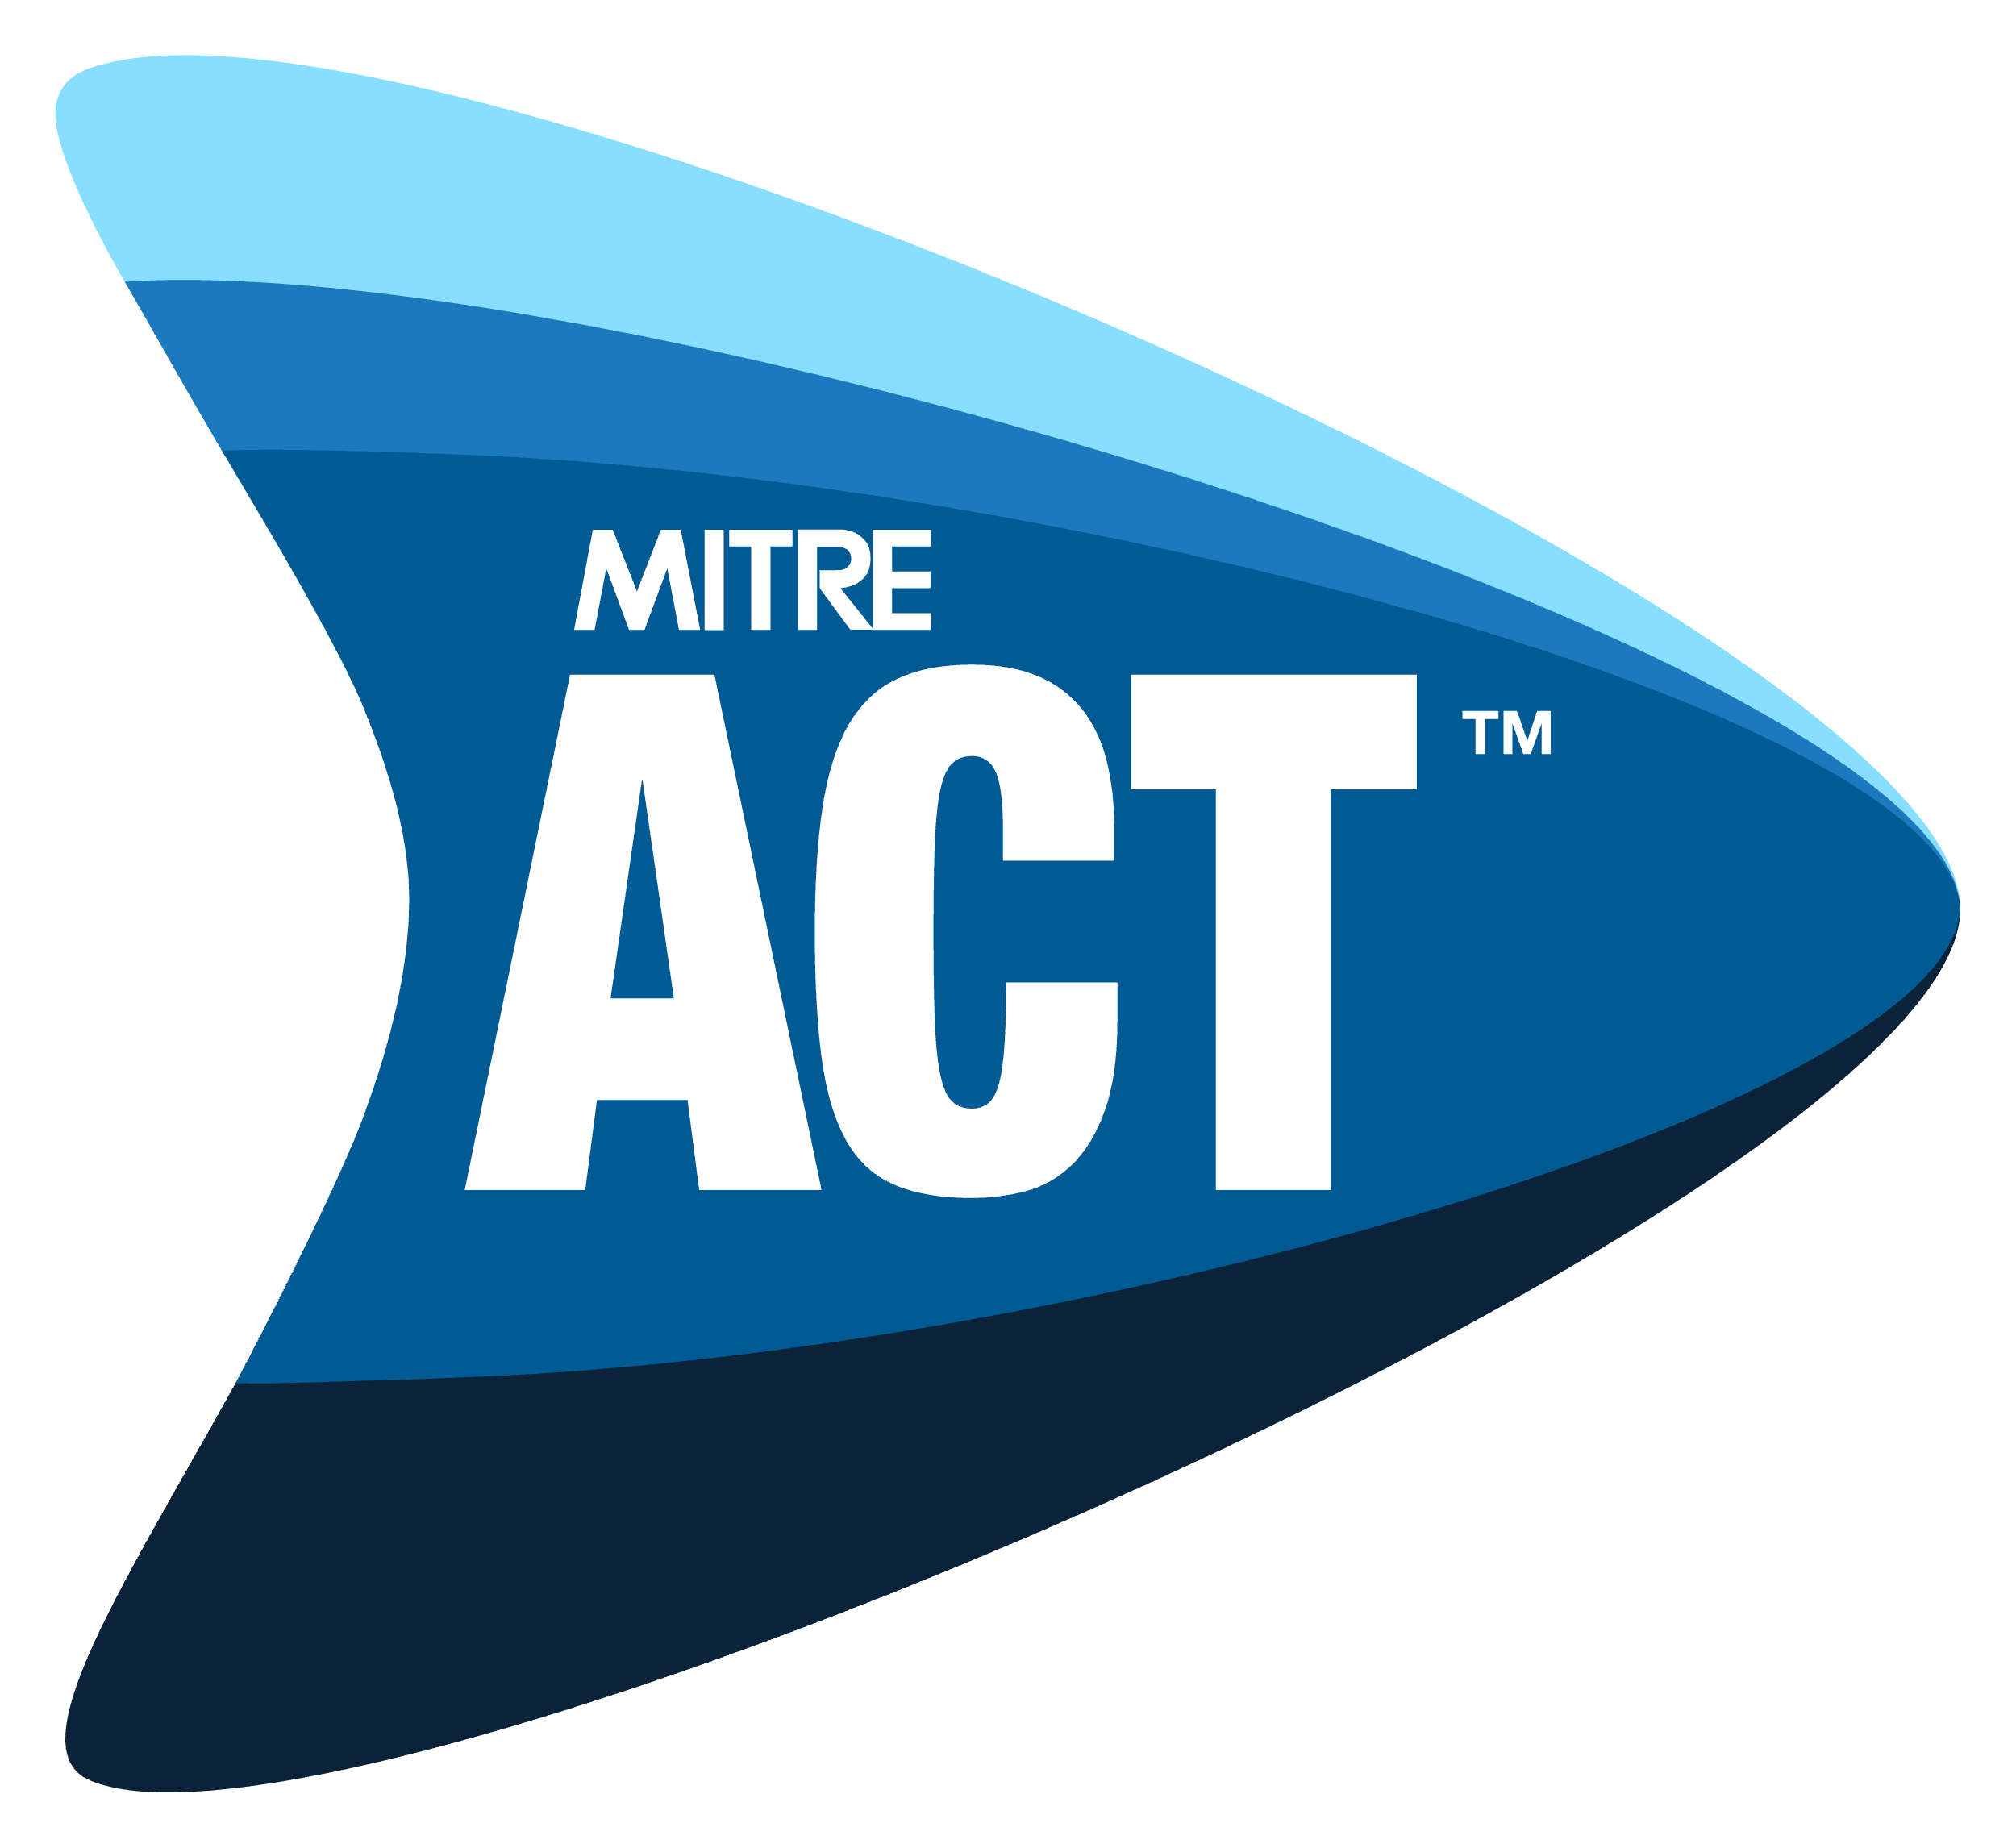
ACT Security & Risk Assessment Preliminary Discussion
<System Name> (<System Acronym>)
<Month DD, YYYY>

Slide 2
What is Adaptive Capabilities Testing (ACT)?
MITRE ACT™ is an assessment framework that provides risk-based context for and integrates various security and compliance assessment programs:
Risk-driven rather than compliance-driven
De-emphasizes technical findings and compliance with Controls (which are still important!); emphasizes risk identification and analysis
Capability-oriented rather than control-oriented
Capabilities state objectives; Controls are specific requirements that help meet those objectives
Utilizes multiple Risk Information Sources (RIS)
Considers all available risk data, not just the results of an SCA
RIS examples: SCA / ACT Security Assessment, Pen Test results, Vulnerability Scans, etc.
More understandable and actionable – adds context and brings conversation to higher level
Isolated security/requirements assessment encourages blind compliance.
ACT facilitates and encourages risk-based decision making.

Slide 3
Key Concepts in ACT
Core Controls: pose the highest risk to <Organization> right now
Assessment of Core Controls is prioritized
Recalculated periodically (always changing)
Security Capability: define mission-oriented security objectives
18 Capabilities divided into multiple Sub-Capabilities (full list available)
Sub-Capabilities mapped to the Controls (and vice versa)
Example: CRED-02: “Ensure the use of strong credentials”; maps to 27 different controls
Risk: explains what the Findings mean
3 types: Inherent (direct), Residual (indirect), and Inherited (from other system)

Slide 4
ACT Assessment Types
ACT Security Assessment: similar to a traditional SCA
Focused on determining compliance with security controls
Involves low-level technical testing, configuration review, interviews, etc.
Technical testing involves Core Controls and sample of non-Core Controls unless otherwise specified
Tells us the state of compliance in isolation
Is a Risk Information Source (RIS)
ACT Risk Assessment: always triggered by ACT Security Assessment
Focused on determining overall-risk to system
Involves review, analysis, and contextualization of all available RIS
Tells us how the findings from different RIS affect each other
Provides data needed to make risk-based decisions about compliance, ATO, etc.

Slide 5
ACT Security Assessment Workflow
Notes:
This slide shows the workflow for an ACT Security Assessment (i.e., a Security Controls Assessment (SCA)).

Slide 6
Notes:
The next slide shows the differences between a Security Assessment and an ACT Risk Assessment.

Slide 7
Notes:
This slide shows the differences in activities and time required to perform an ACT Risk Assessment vs. a Security Assessment.
Note that the timeline is greatly reduced.

Slide 9
System Overview
System Team provides:
description of system purpose and functions
description of system development roadmap
current state
planned changes in next 12 months (with dates)

Slide 10
Review Preliminary Intake Form

Slide 11
Artifacts Required to Move Forward
Please provide all “Tier 1” Artifacts and any existing “Tier 2” Artifacts from the lists in the Preliminary Intake Form.
Prepend filenames with the appropriate Artifact ID(s) (for example, add “A1-01” to the beginning of your SSP’s filename)
Some files might help meet more than one Artifact ID – if so, prepend the filename with all applicable IDs.

Slide 12
Next Steps
ACT Lead
Deliver Preliminary Meeting Notes (with Action Items)
Provide test account creation information
Verify test accounts after creation
Deliver Assessment Plan(s)
Schedule other meetings, and assessment interviews
ISSO/ISSM and System Team
Tag and provide Tier 1 and Tier 2 artifacts
Provide answers to any open questions
Create and provide test accounts for ACT Team verification

Slide 13
Action Items Creation

Slide 14
Contact Information
<Assessment Team Contact Information>

Slide 15
Questions?

